Slide 1

Naive Bayes classifier for Fake News recognition
Advanced Statistics for Physics Analysis
Prof. Garfagnini

Slide 2

Outline
What is the problem?
Datasets and preprocessing
The algorithm and Its Implementation in R
Evaluating the results
Conclusions

Slide 3

What are fake news? And why does it matter?
Fake news: false stories produced with the intent of confusing or deceiving people.
They represent a pressing issue, as the widespread use of social media has increased the speed at which false information spreads.
We will tackle this by developing an algorithm for the prediction of fake news, based on text classification with the Naive Bayes method.

Slide 4

Datasets
Fake News Content Detection
Train
Test
Sample submission
Fake News Classification
Train
Test
Evaluation

Slide 5
🔍 Data Usage Strategy
For the first the set we use only the training file because it’s the one that is labeled. To evaluate our model, we split it into training and validation sets.
For the second dataset, we use the evaluation data. This decision can be justified by our intention to test the method on a binary classification dataset with a similar number of samples as the first dataset.
We split our dataset into 80% for training and 20% for evaluating the performance of the model.

Slide 6
What can we say about our data?
Fake News Content Detection
10240 labeled sample in Train
3 columns
Labels
Text
Text_Tag
6 different category labels
True - 5
Not-Known - 4
Mostly-True - 3
Half-True - 2
False - 1
Barely-True - 0
The dataset is clean, with no missing values or need for data type conversion.

Slide 7
What can we say about our data?
Fake News Classification - Raw data
36454 labeled sample in evaluation set
1 column, but contains:
Num(index)
Title
Text
Label
Binary classification
Fake(0)
True(1)

Slide 8
What can we say about our data?
Fake News Classification - Raw data Issues and Solutions
The dataset is not well-formatted. We split it’s column into four separate columns for better usability.
Some rows contain missing or invalid labels, which we removed during cleaning.
The Num column serves only as an index and is not useful for analysis, so we dropped it.
We converted the Labels column to numeric to ensure consistency with the first dataset and to make it more suitable for modeling.
We reordered the columns to Labels, Text, and Text_Tag to improve clarity and maintain consistency.
We removed Rows with Text entries shorter than 20 characters , as such short texts are unlikely to provide enough information for effective classification.

Slide 9
What can we say about our data?
Fake News Classification - Cleaned
Binary classification
Fake(0)
True(1)
21662 labeled sample
3 columns
Labels
Text
Text_Tag

Slide 10
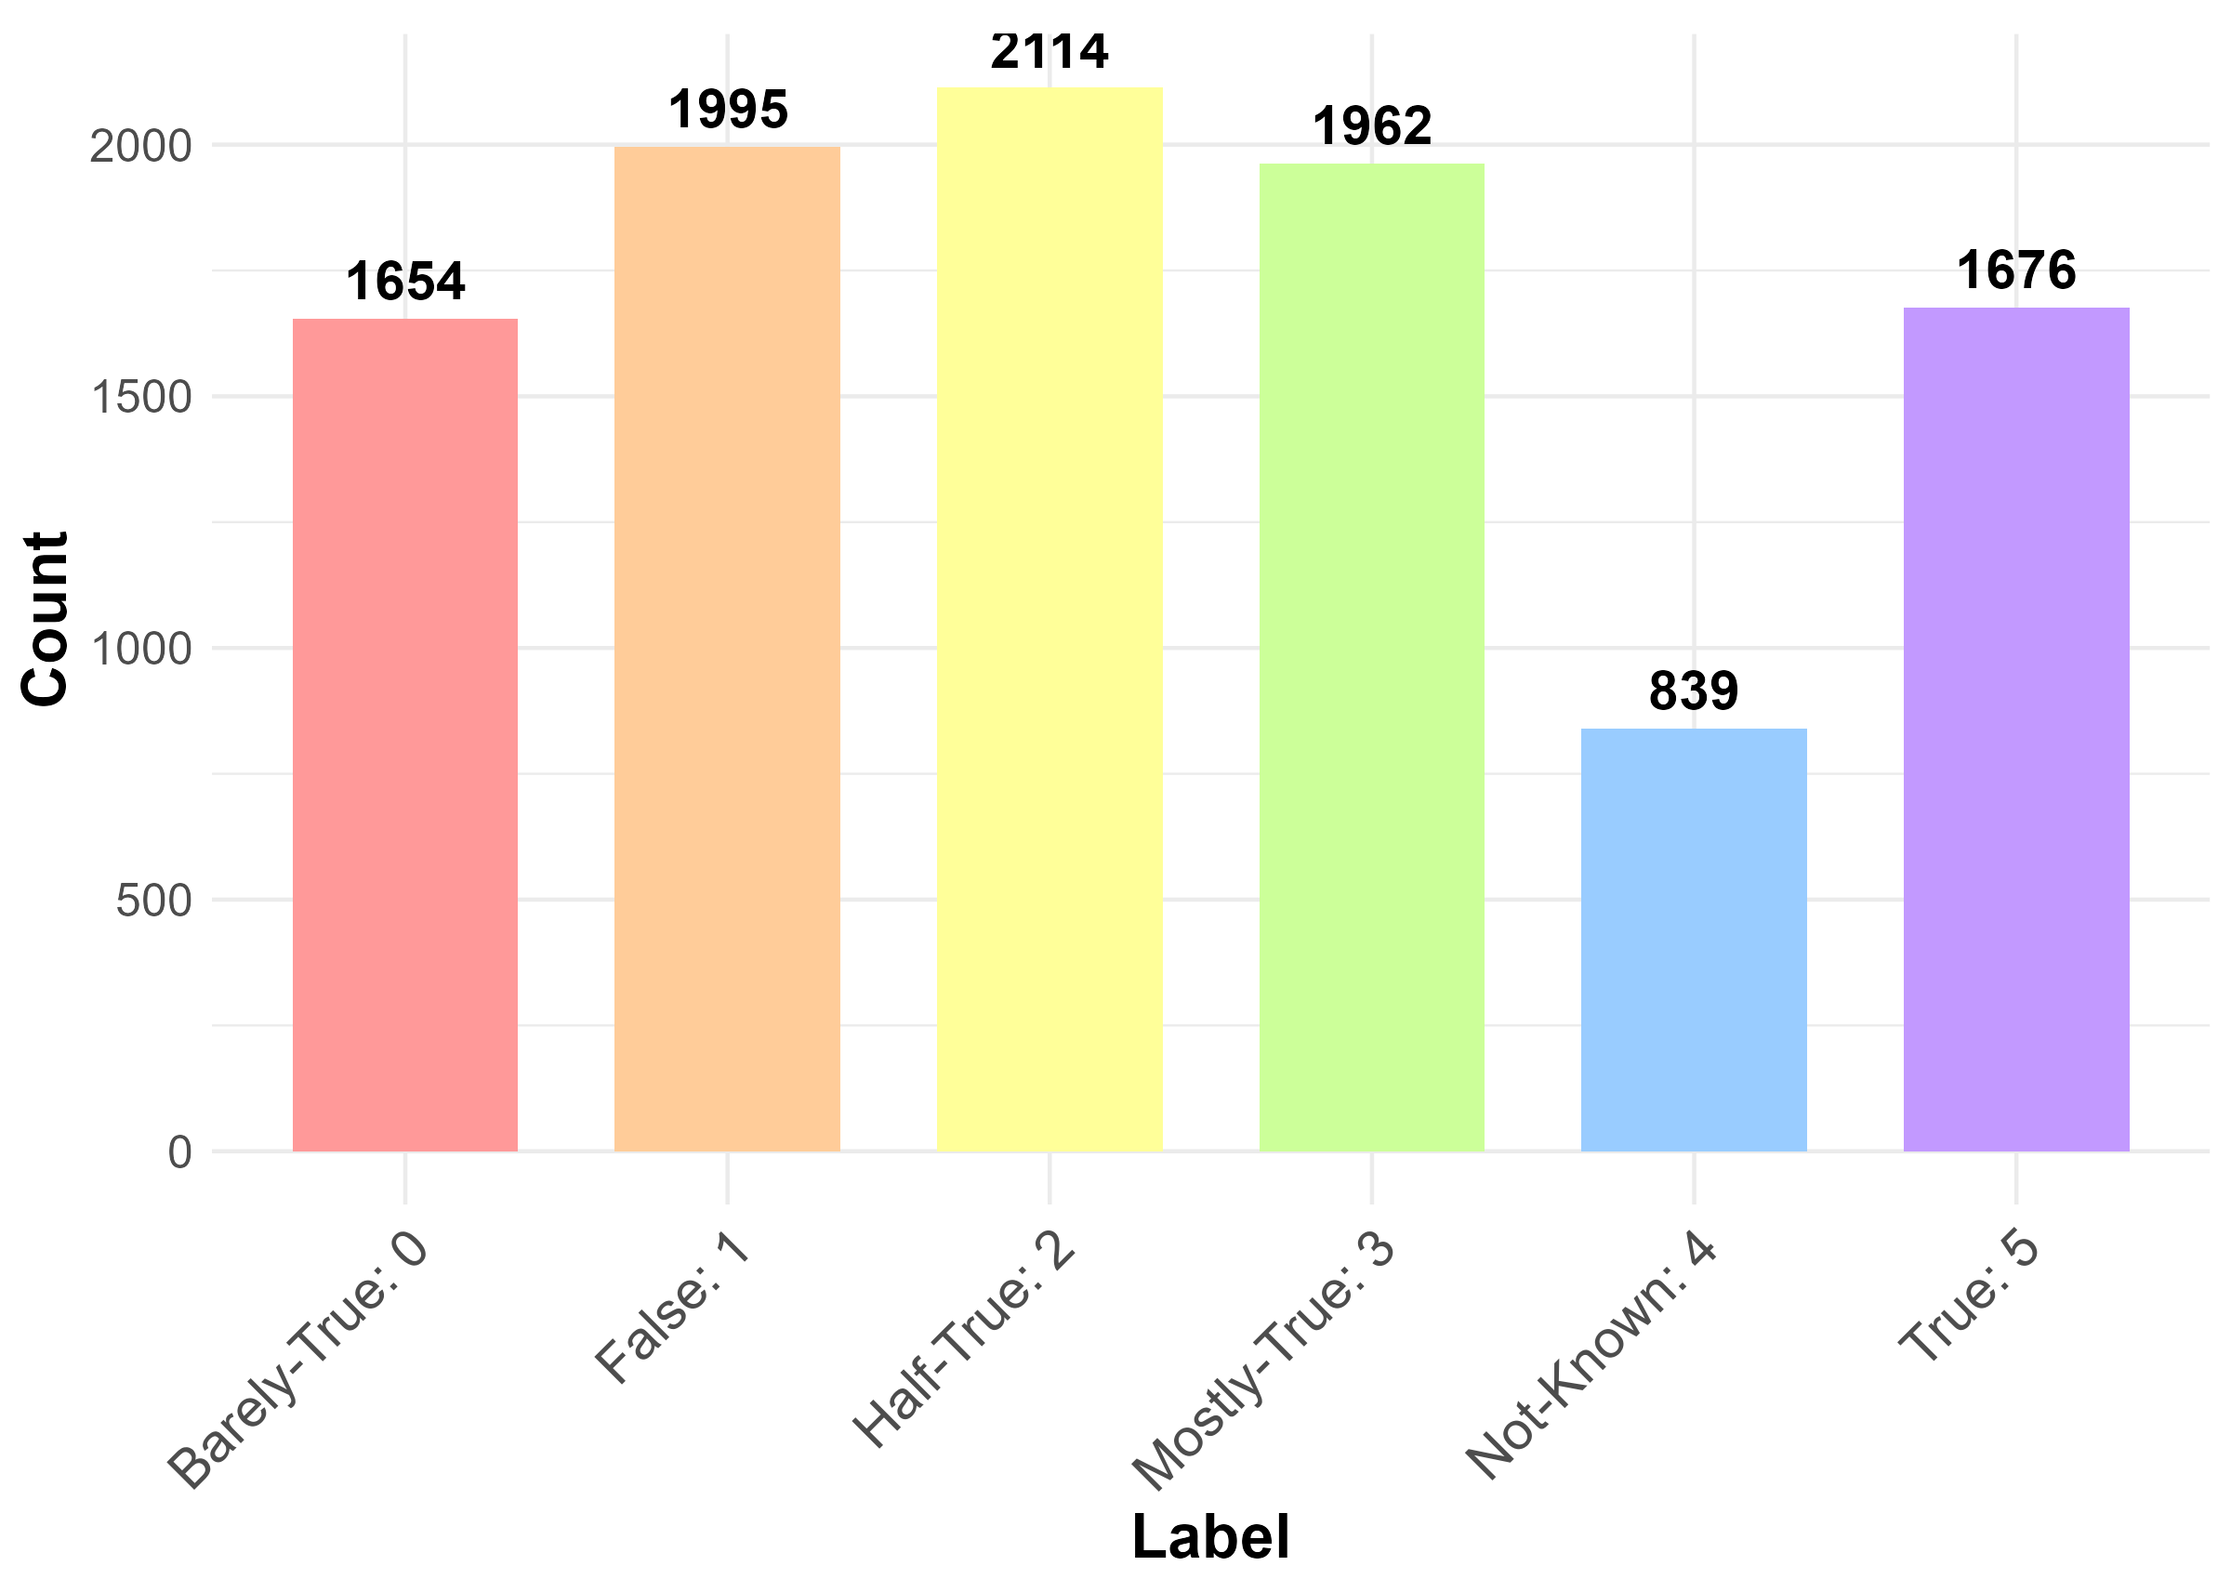
Distribution of Labels (Multi-class Data)

Slide 11
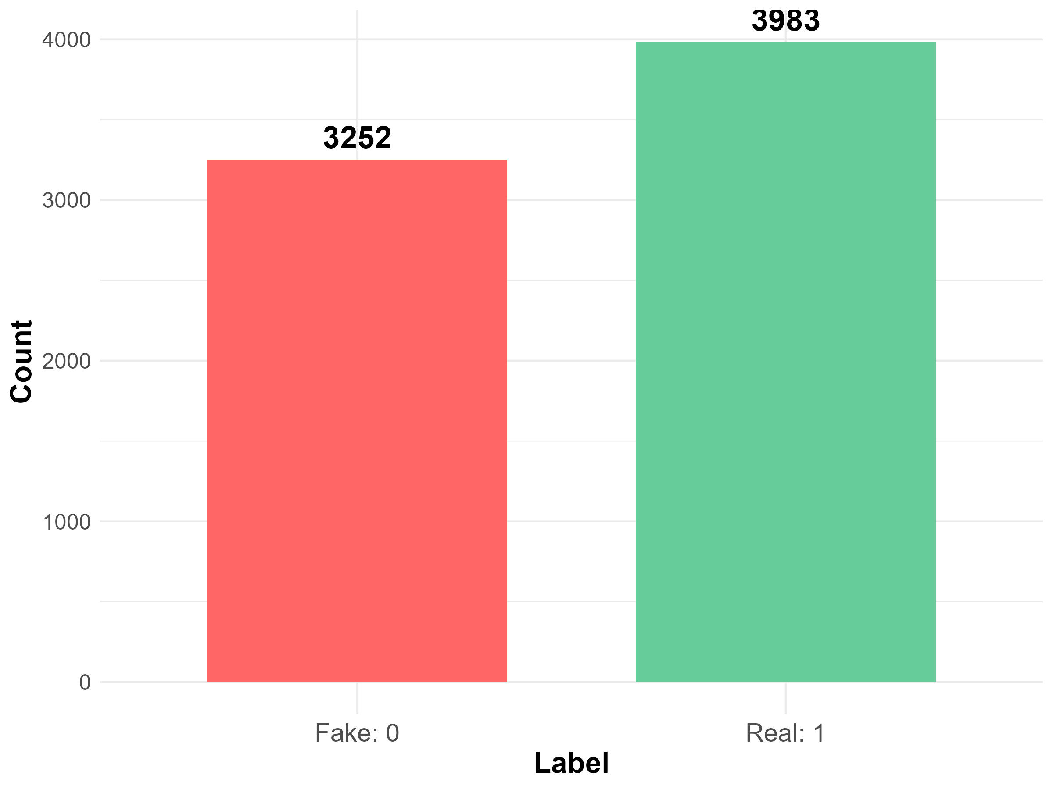
Distribution of Labels (Binary-class Data)

Slide 12
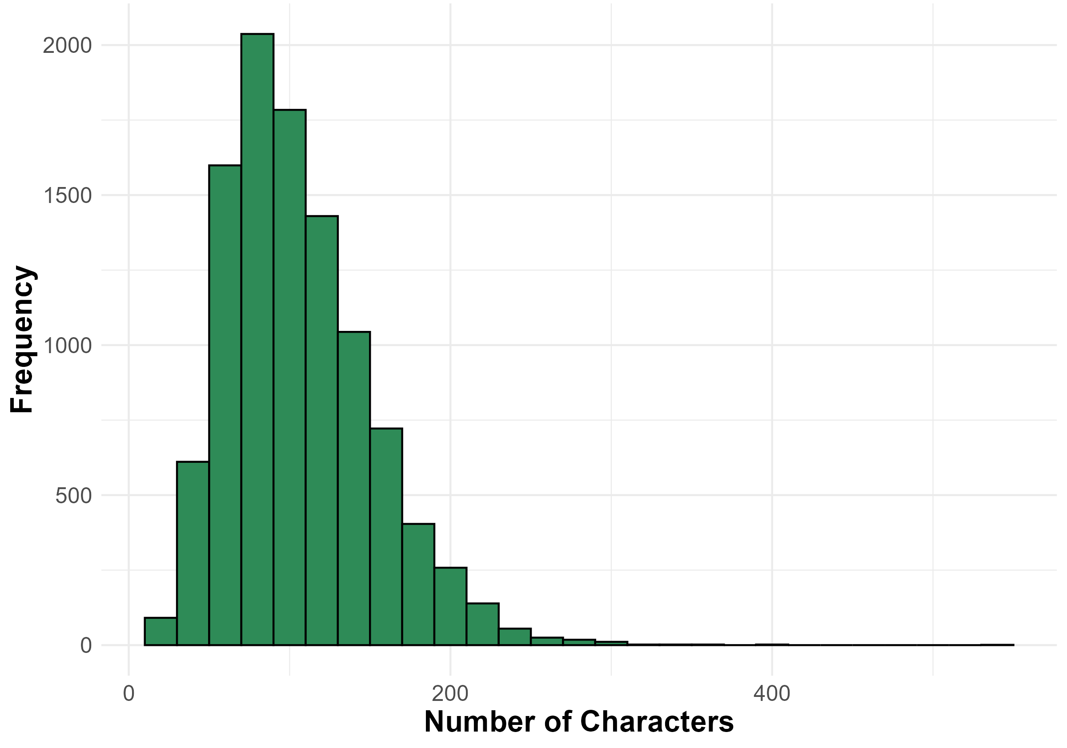
Text Length Analysis (Multi-class Data)
Text Length Distribution
in multi-class Data
(≤ 1000 Characters)

Slide 13
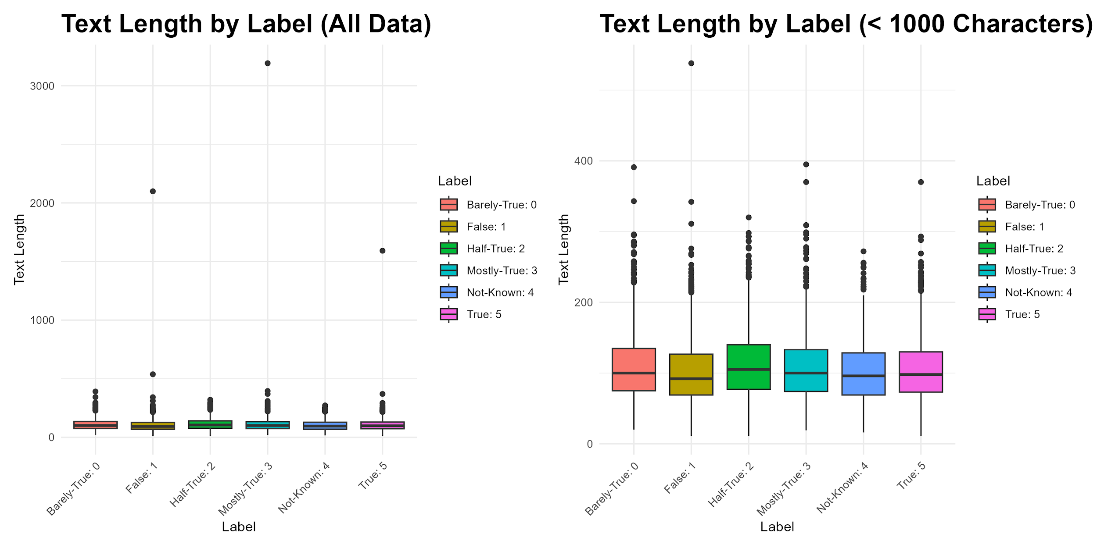

Slide 14
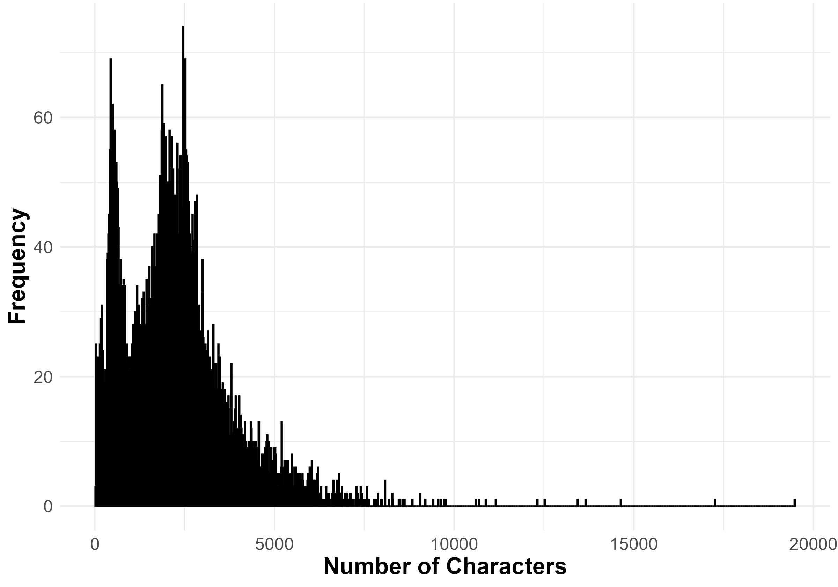
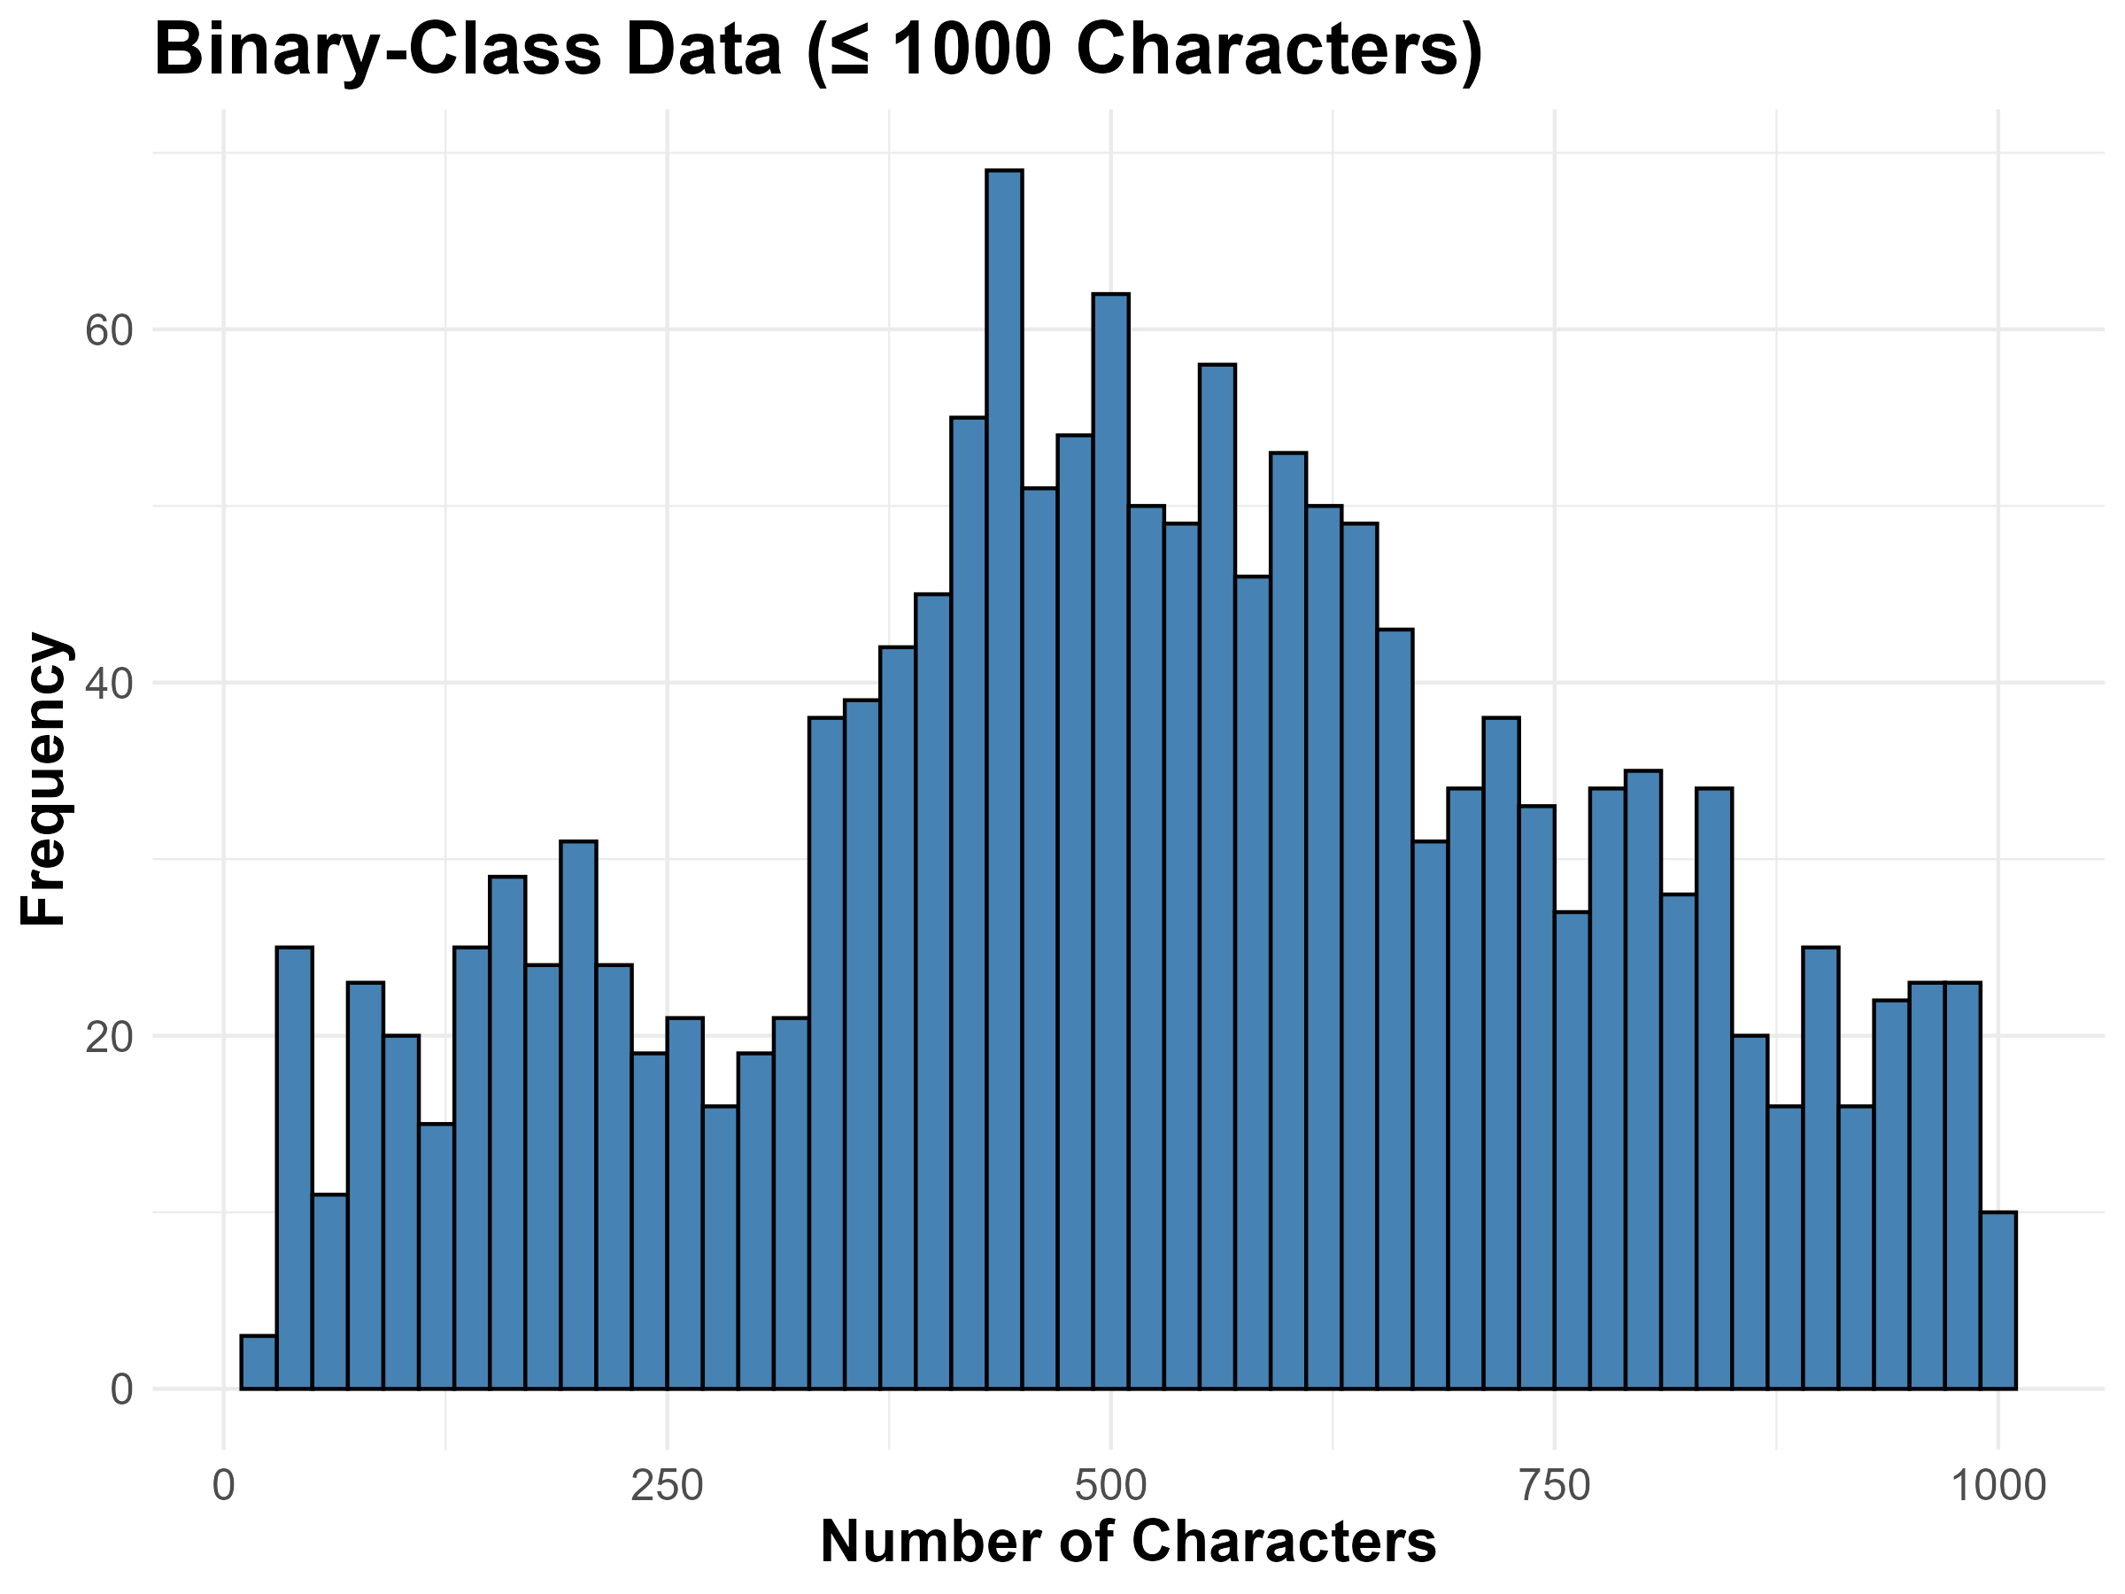
Text Length Analysis (Binary-class Data)
Compared to the multiclass dataset, the binary class texts are generally longer. Some samples are extremely large, and we might consider treating them as outliers.

Slide 15
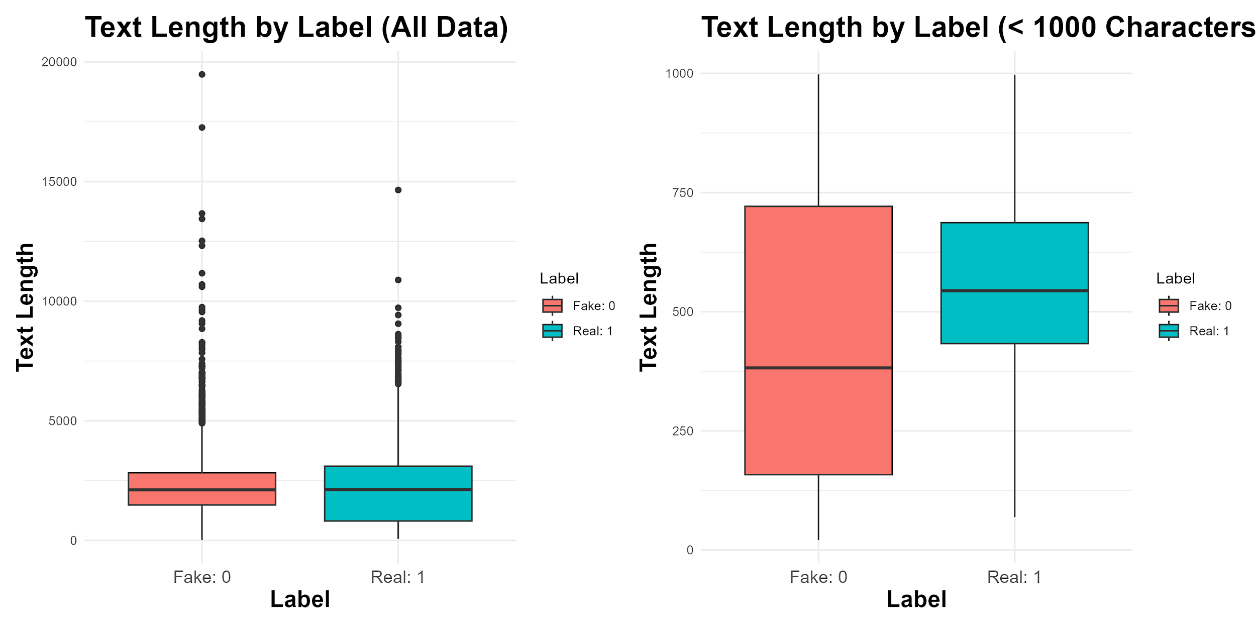

Slide 16
What about the “Third” column
In the Naive Bayes modeling approach, we focused solely on the main Text and Labels, excluding other features like the news title or text_tag.
While this approach simplifies the model, it may overlook valuable contextual cues.
More complex models, such as Neural Networks, could potentially leverage these additional features to improve classification accuracy by capturing deeper semantic relationships.

Slide 17
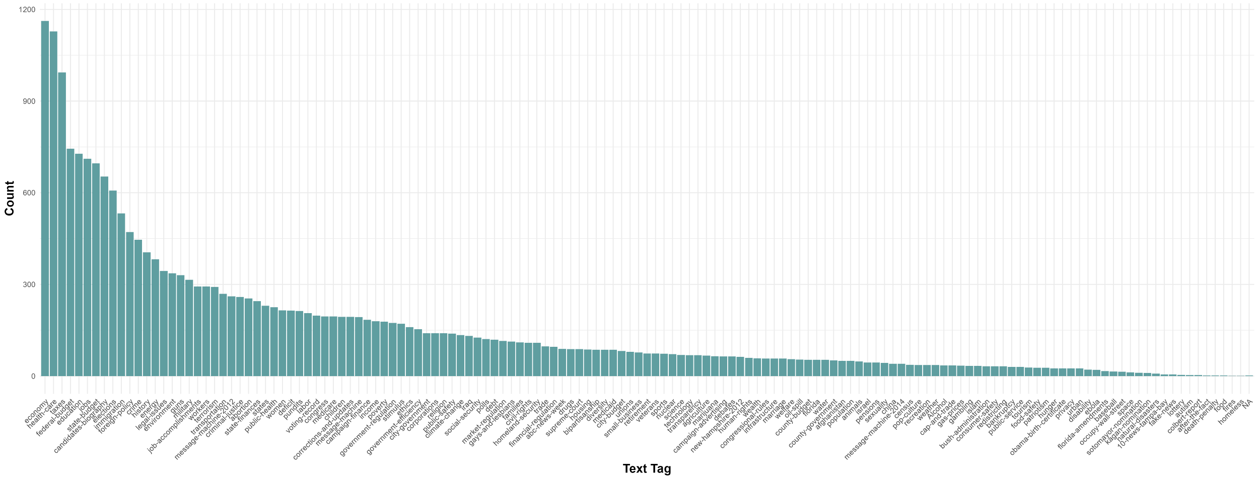
Distribution of News Tags in Multi-class data

Slide 18
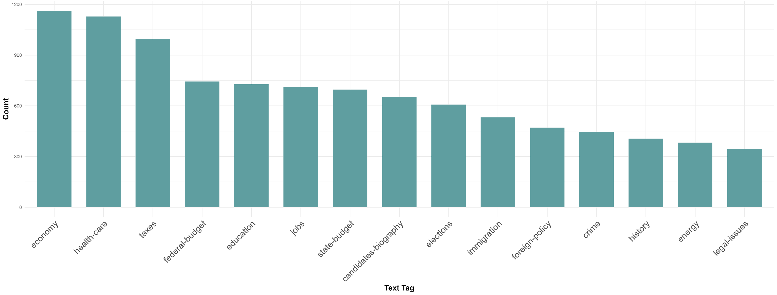
Top 15 News Tags in Multi-class data

Slide 19
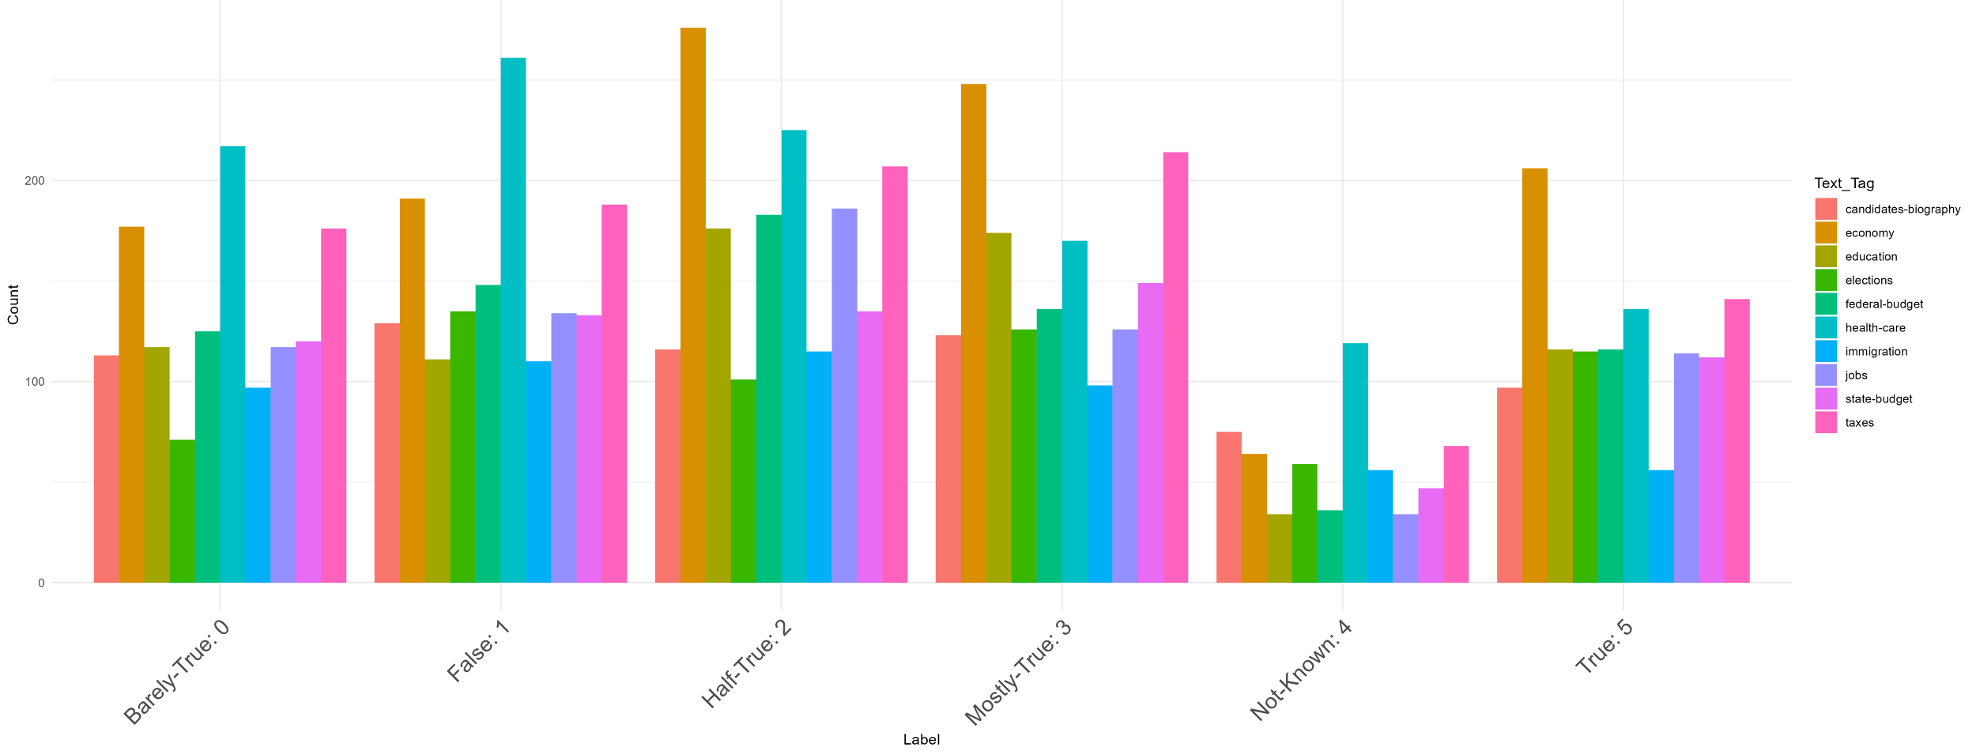
Label Distribution per Category (Text_Tag) - Top 10

Slide 20
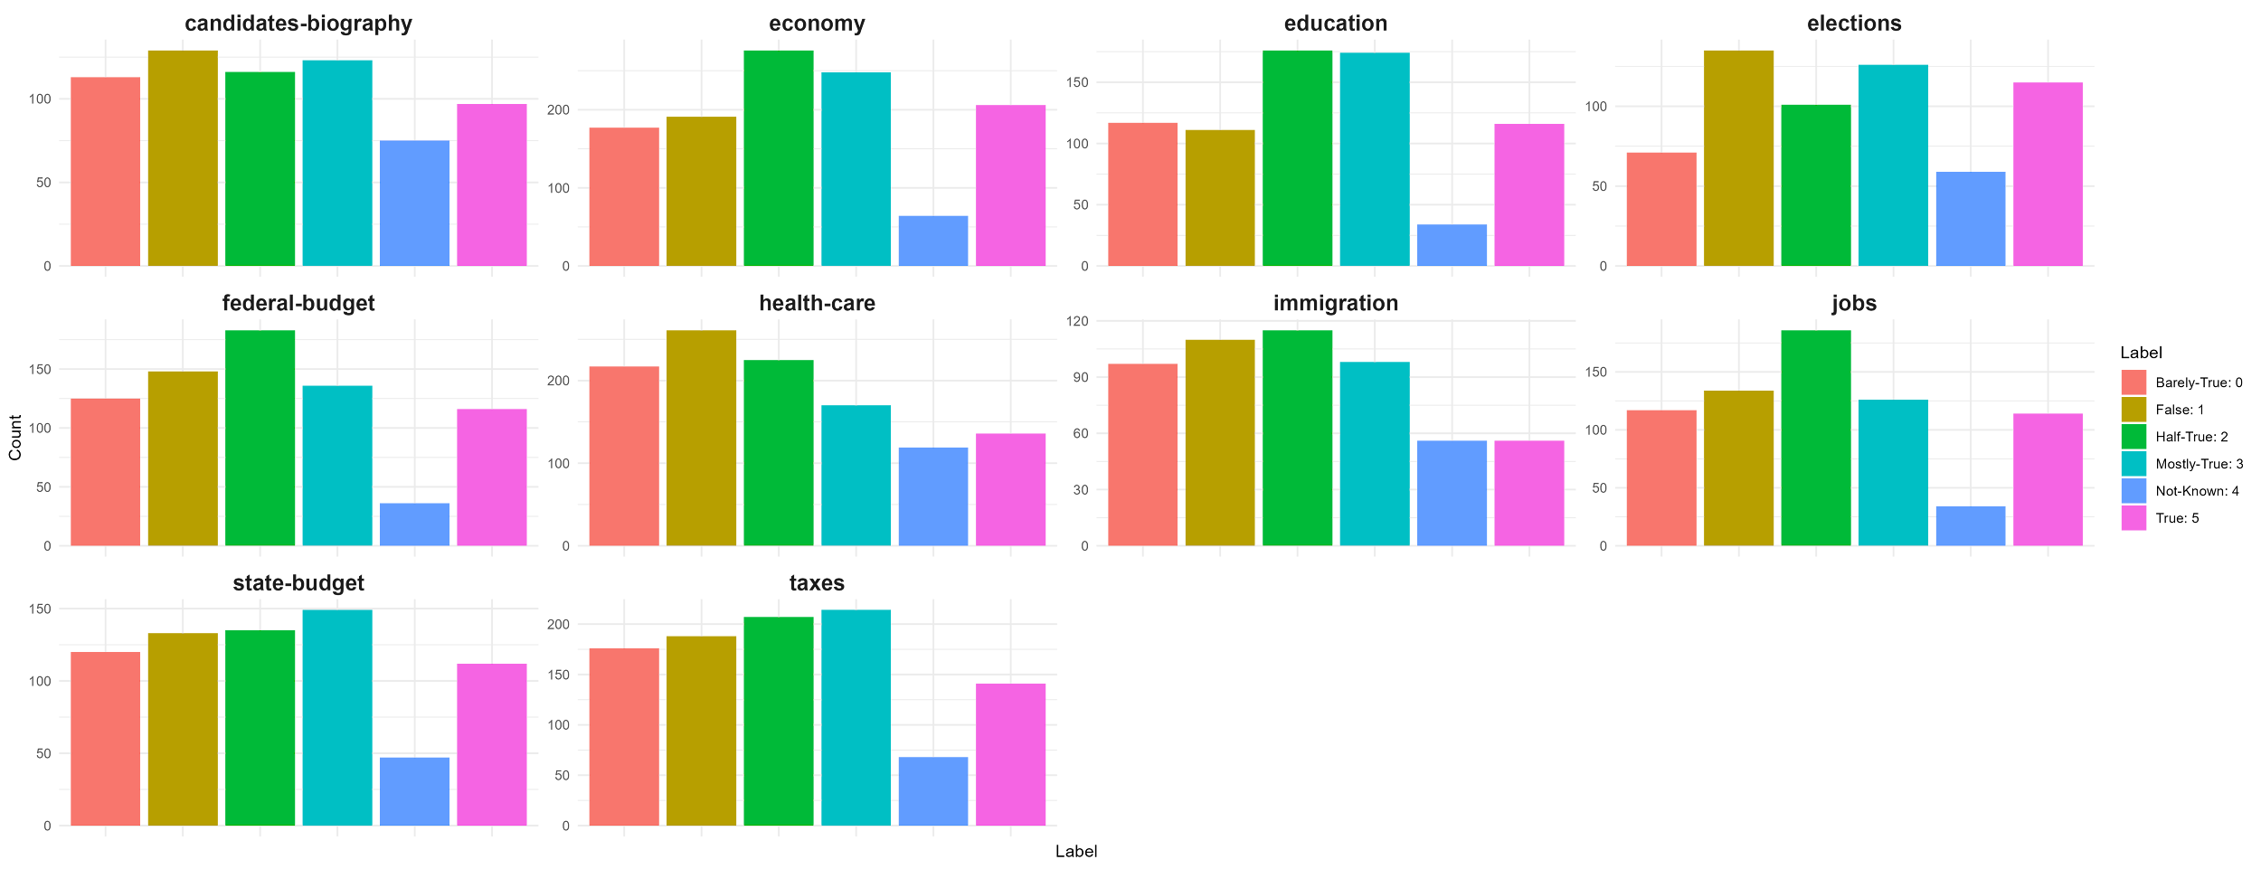
Label Distribution per Top 10 Category - Faceted Plots

Slide 21
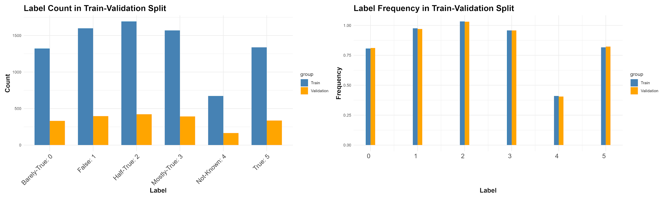
Train-validation Split & Preprocessing
Stratified Sampling (caret):
Ensures balanced class distribution in train-validation split.
Text Preprocessing & Encoding:
Clean and standardize text, then convert to numeric format for compatibility with Naive Bayes.

Slide 22
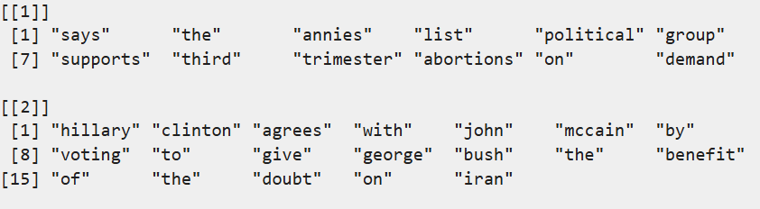
How can we prepare text sequences for classification?
we defined 4 different preprocessing steps and NLP techniques on our data and tried to compare their results and performances.
Basic processing
Stopword removal
Stemming
Lemmatization
Clean & Tokenizing:
Removing punctuation
Replacing multiple spaces with a single space
Converting all text to lowercase
Splitting the text into individual word tokens
Numerical Representation
Identifies unique terms
Assigns each term a unique numeric ID starting from 1

Slide 23
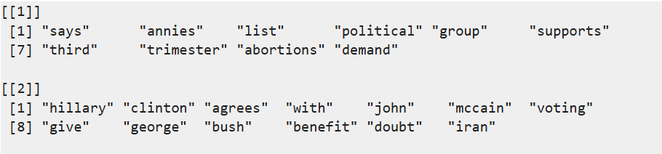
Developing More Advanced Text Processing
Stopword Removal:
Performs basic preprocessing and removes short, common stopwords (under 4 characters), targeting high-frequency function words such as “the”, “and”, and “not”.

Slide 24
Developing More Advanced Text Processing
Stemming
In addition to basic preprocessing, we applied stemming to reduce words to their root form.
This helps unify word variants, reducing feature space sparsity. While effective for general meaning, it may produce non-standard word forms.
"running" → "run"
"better" → "better"
"played" → "play"
"connection" → "connect"
note: not always a real word
"flies" → "fli"
"studies" → "studi"
"says" → "sai"

Slide 25
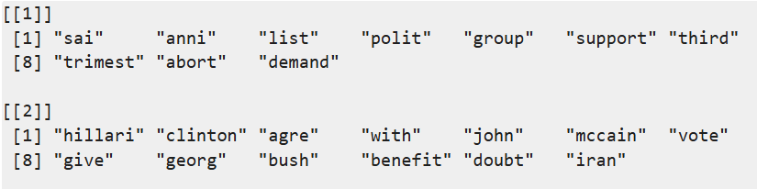
Stemming
Purpose:
Groups different forms of a word (e.g., "run", "running", "runs") into a single token.
Reduces vocabulary size.
Helps machine learning models treat related words as the same feature.
Limitation:
Stemming can be aggressive and may produce non-dictionary forms (e.g., "studies" → "studi").
Common Algorithms:
Snowball Stemmer
Porter Stemmer
Lancaster Stemmer

Slide 26
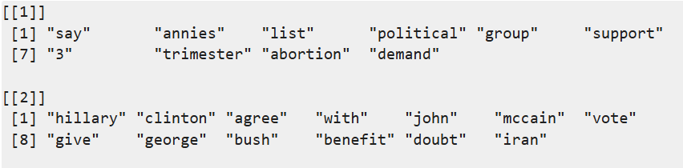
Developing More Advanced Text Processing
Lemmatization
is the process of reducing words to their base or dictionary form, known as the lemma.
Unlike stemming, lemmatization considers the context and grammar of the word, ensuring the resulting form is a valid word.

Slide 27
Lemmatization
Pros:
Linguistically accurate: Returns real words
Context-aware: Considers part of speech and grammar.
Reduces noise: Improves consistency in features for text models.
Cons:
More complex and Slower
Language-dependent: Requires a lemmatizer for each language.
"running" → "run"
"studies" → "study"
"better" → "good"
"was" → "be"
"flies" → "fly"
"says" → "say"
"children" → "child"
"driven" → "drive"
"happiest" → "happy"

Slide 28
Building Vocabulary & feature selection
4 different preprocessing pipeline:
Basic (punctuation, multi-space, lowercase, tokenizing)
Basic + stopword removal (“the”, “and”, “not”)
Basic + stopword removal + Stemming
Basic + stopword removal + Lemmatization
Number of unique vocabularies(tokens):
Vocabulary Size (Basic Processing): 11164
Vocabulary Size (Basic + Stopword removal): 11044
Vocabulary Size (Basic + Stopword removal + stemming): 7617
Vocabulary Size (Basic + Stopword removal + lemmatization): 8317

Slide 29



The Naive Bayes method for text classification
One way to identify fake news is to rephrase the problem in terms of text classification:
We are given some text , where is our input space, and a fixed set of classes .

Slide 30
The Naive Bayes method for text classification
One way to identify fake news is to rephrase the problem in terms of text classification:
We are given some text , where is our input space, and a fixed set of classes .
For instance, the classes may represent different levels of truthfulness.

Slide 31

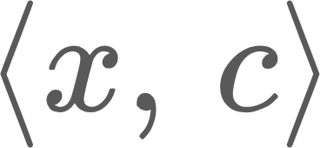
The Naive Bayes method for text classification
One way to identify fake news is to rephrase the problem in terms of text classification:
We are given some text , where is our input space, and a fixed set of classes .
For instance, the classes may represent different levels of truthfulness.
We have a training dataset , that consists of labeled text examples .

Slide 32

The Naive Bayes method for text classification
One way to identify fake news is to rephrase the problem in terms of text classification:
We are given some text , where is our input space, and a fixed set of classes .
For instance, the classes may represent different levels of truthfulness.
We have a training dataset , that consists of labeled text examples .
Our task is to learn, from the training data, a classification function:

Slide 33


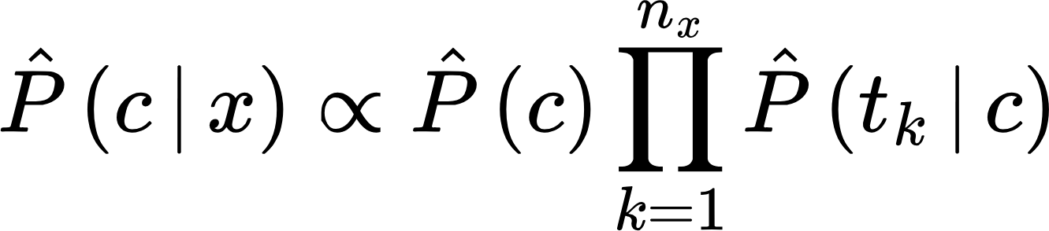



The Naive Bayes method for text classification
In the Naive Bayes method, we learn the probability of a document being in class :
: number of terms in
: k-th term in
Posterior
Prior
Likelihood

Slide 34
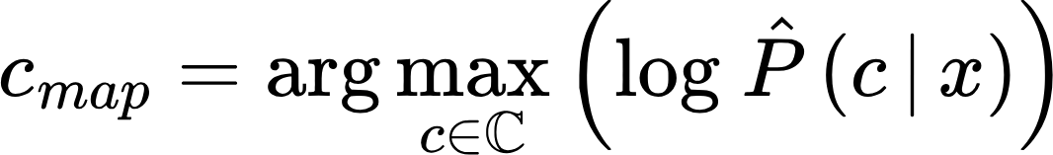
The Naive Bayes method for text classification
In the Naive Bayes method, we learn the probability of a document being in class :
: number of terms in
: k-th term in
Posterior
Prior
Likelihood
Since we are interested in predicting the most likely class, we use the maximum a posteriori (MAP) estimator:

Slide 35
The Naive Bayes method for text classification
In the Naive Bayes method, we learn the probability of a document being in class :
: number of terms in
: k-th term in
Posterior
Prior
Likelihood
Since we are interested in predicting the most likely class, we use the maximum a posteriori (MAP) estimator:
Numerically stable

Slide 36
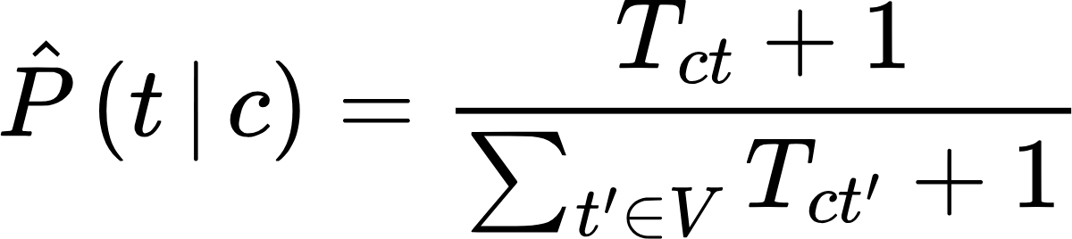
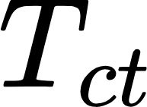



The Naive Bayes method for text classification
Here, the prior is simply the relative frequency of the classes in the training data.
The likelihood is computed as the relative frequency of the term within the class:
We implement Laplace smoothing to avoid issues during inference, caused by terms not present in the training data.
: occurrences of term in class
: training vocabulary

Slide 37
Implementation of Naive Bayes in R
Organizing and preparing the data:
Structure of preference → dataframes
Label | Text
1 | Says the Annies List political group supports…
2 | When did the decline of coal start? It started…
3 | Hillary Clinton agrees with John McCain…
…
…

Slide 38
Implementation of Naive Bayes in R
Organizing and preparing the data:
Structure of preference → dataframes
Stratified train-validation split → generate training and validation datasets
# Draw a random, stratified sample including p percent of the data
idx.train <- createDataPartition(y = fakeNewsTrain$Labels, p = 0.8, list = FALSE)
# Training set with p = 0.8
trainData <- fakeNewsTrain[idx.train, ]
# Validation set with p = 0.2
validationData <- fakeNewsTrain[-idx.train, ]

Slide 39
Implementation of Naive Bayes in R
Organizing and preparing the data:
Structure of preference → dataframes
Stratified train-validation split → generate training and validation datasets
Data processing → cleaning and preparing the text sequences
process_data <- function(data_var) {
result <- data_var$Text # Init variable
result <- gsub("[[:punct:] ]+", " ", result) # Remove punctuation
result <- tolower(result) # Turn everything into lowercase
result <- strsplit(result, split=" ") # Split by whitespaces
# Additional techniques: remove stopwords, stemming, lemmatization
# ...
result
}

Slide 40
Implementation of Naive Bayes in R
Building the Naive Bayes model :
Initializing of model vocabulary → dataframe with known terms
generate_numerical_mapping <- function(termsVar){
flatTerms <- unlist(termsVar) # Single vector with all the terms
uniqueTerms <- unique(flatTerms) # Unique words
uniqueNum <- length(uniqueTerms) # Number of unique terms
d <- data.frame(Term = uniqueTerms, Id = c(1:uniqueNum)) # Build mapping
d
}
numMapping <- generate_numerical_mapping(trainProcessed)

Slide 41
Implementation of Naive Bayes in R
Building the Naive Bayes model :
Initializing of model vocabulary → dataframe with known terms
Defining the data structure for the prior → dataframe with class labels and relative frequency
Label | Relative frequency
0 | 0.32
1 | 0.25
…
…

Slide 42
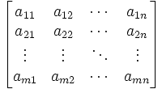
Implementation of Naive Bayes in R
Building the Naive Bayes model :
Initializing the model vocabulary → dataframe with known terms
Defining the data structure for the prior → dataframe with class labels and relative frequency
Defining the data structure for the likelihood → matrix with the likelihood of each known term for each possible class
Classes
Terms

Slide 43
Implementation of Naive Bayes in R
Training the model :
Estimating the prior → count number of occurrences for each class and divide by the total number of samples
train_prior <- function (dataVar){
uniqueLabels <- unique(dataVar$Labels) # Get all the labels from the data
labelCounts <- table(dataVar$Labels) # Get counts
labelData <- as.data.frame(labelCounts) # Turn into dataframe
labelData$RelFreq <- labelData$Freq / nrow(dataVar) # Get relative frequency
labelData
}
# Estimate prior from our training data
priorBayes <- train_prior(trainData)

Slide 44
Implementation of Naive Bayes in R
Training the model :
Estimating the prior → count number of occurrences for each class and divide by the total number of samples
Estimating the log-likelihood → from occurrences of terms and Laplace smoothing
train_log_likelihood <- function(dataVar, mappingVar, processingFunc){
uniqueLabels <- unique(dataVar$Labels) # Get unique labels
termsM <- matrix(0,nrow=nrow(mappingVar),ncol=length(uniqueLabels)) # Init counts
for (i in uniqueLabels){
# Get data in the same class, process text, get counts for each term...
termsM[mappedText$Id,labelIdx] = mappedText$Freq # Update counts matrix
}
topTerm <- termsM + 1 # Laplace smoothing
M <- log(topTerm) - log(colSums(topTerm)) # Get log-likelihood matrix
M}

Slide 45
Implementation of Naive Bayes in R
Using the model for inference :
naiveBayesPredict <- function(dataVar, priorVar, logLikeliVar, mappingVar,
processingFunc=process_data){
processedText <- processingFunc(dataVar) # Process text input
predClass <- 0*c(1:nrow(dataVar)) # Init results
for (i in c(1:nrow(dataVar))){ # Operate separately for each input case
inputText <- processedText[i] # Get input data
countsTerms <- as.data.frame(table(inputText)) # Counts for each term and map
names(countsTerms)[names(countsTerms) == "inputText"] <- "Term"
mappedText <- merge(mappingVar, countsTerms, by = "Term")
weightsTerms <- logLikeliVar[mappedText$Id,1:nrow(priorVar)] # Get weights
logLikelyTerms <- colSums(mappedText$Freq*weightsTerms) # Get log-likelihood
logPosteriorTerms <- logLikelyTerms + log(priorVar$RelFreq) # Add log-prior
predClass[i] = which.max(logPosteriorTerms) - 1 # Get predicted class with MAP
}
predClass}

Slide 46
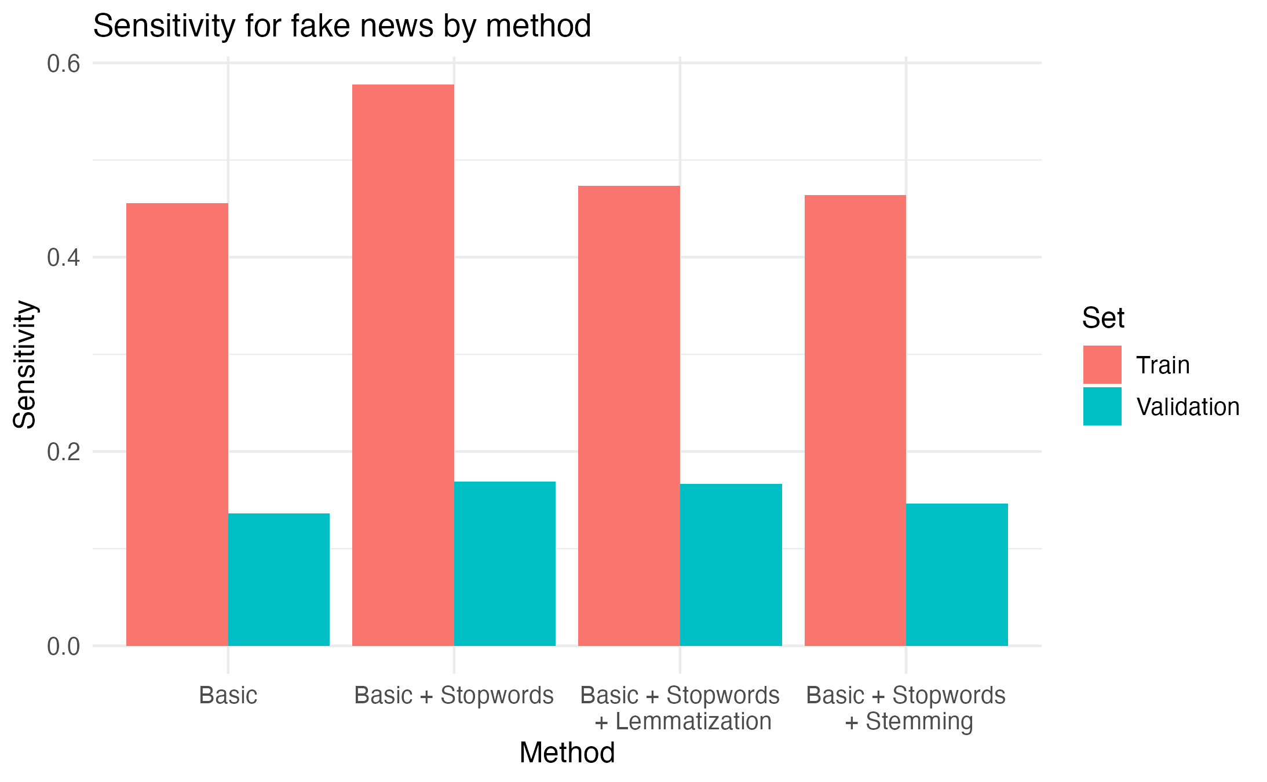

Results: multi-class classification
Sensitivity:
Poor sensitivity in multi-class classification and even worse performance in the validation set.
In data preprocessing, stop words have a better effect, while other methods have little impact

Slide 47
Results: multi-class classification
Sensitivity:
Neglecting more correct labels in prediction

Slide 48
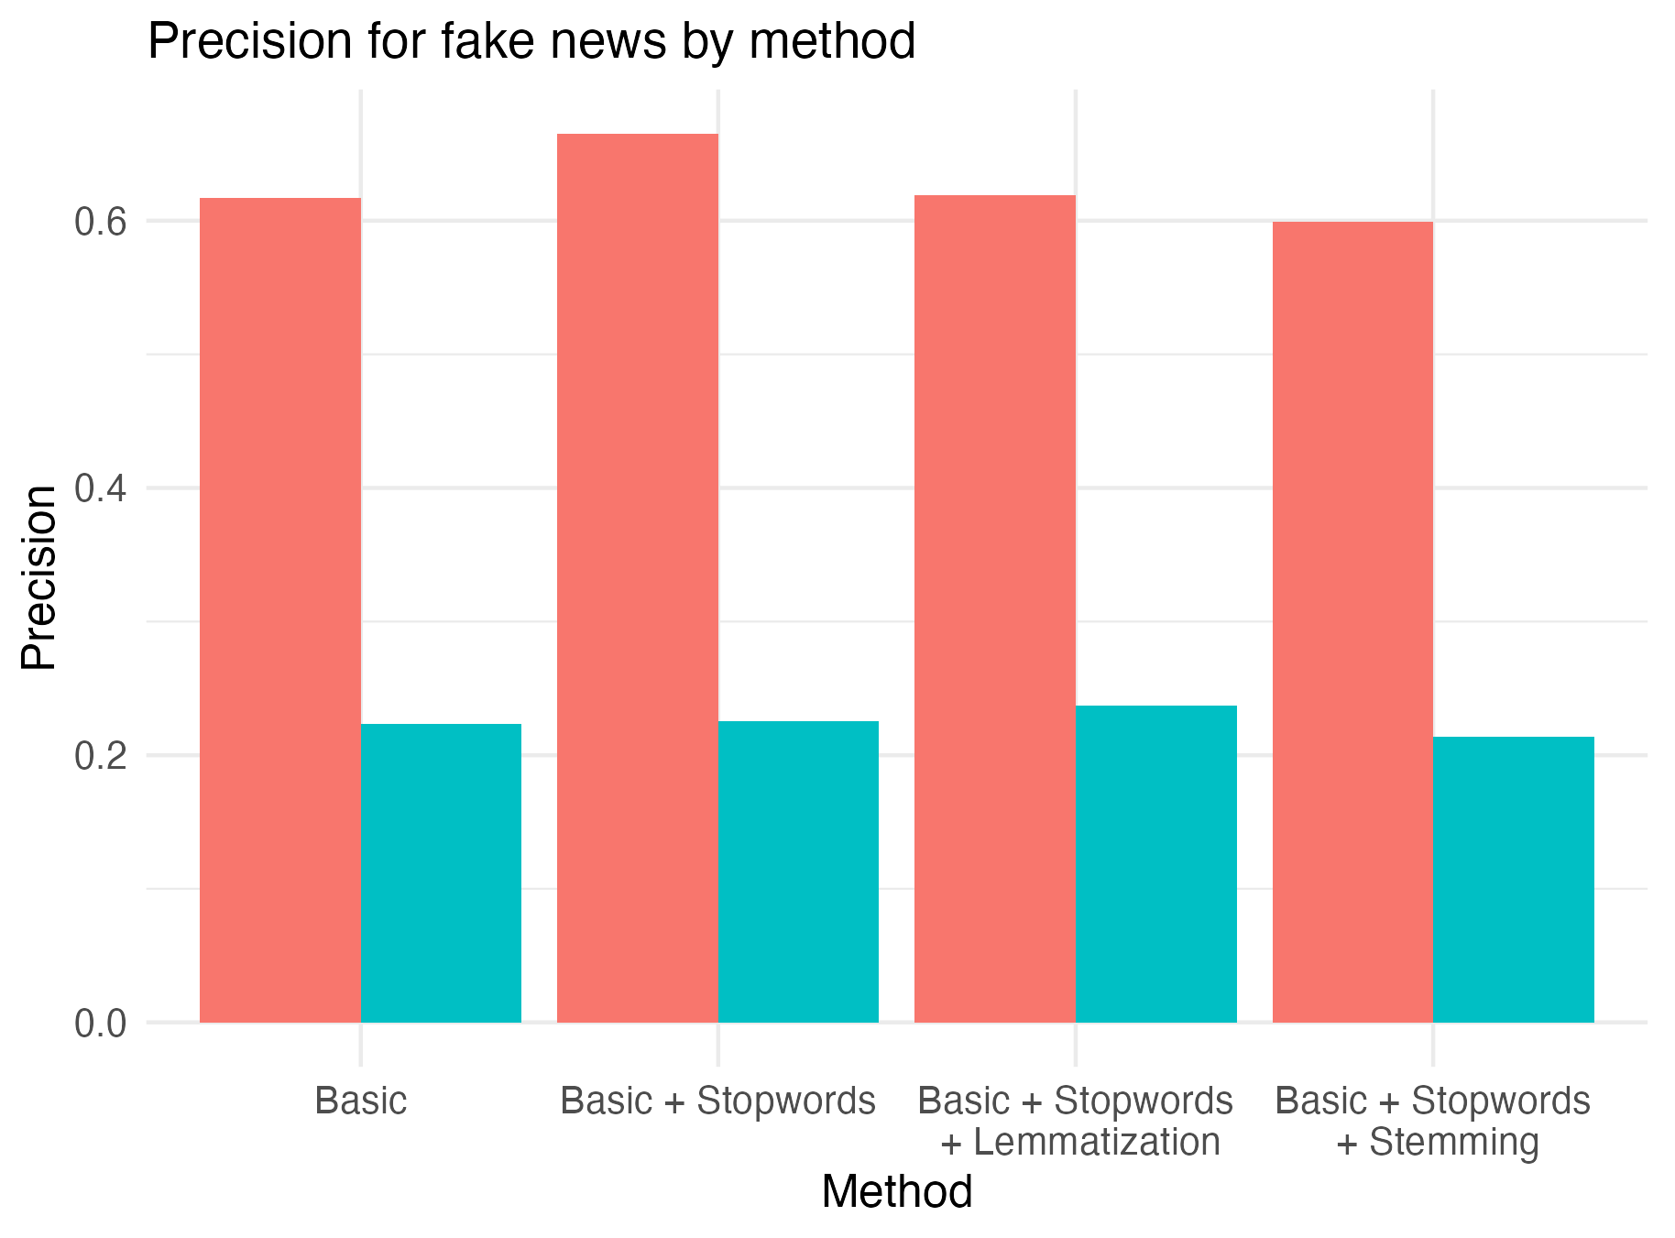

Results: multi-class classification
Precision:
Precision performance is better than sensitivity, and the impact of data preprocessing is not significant

Slide 49
Results: multi-class classification
Precision:
Compared to ignoring correct predictions, there are fewer incorrect predictions in predictions.

Slide 50
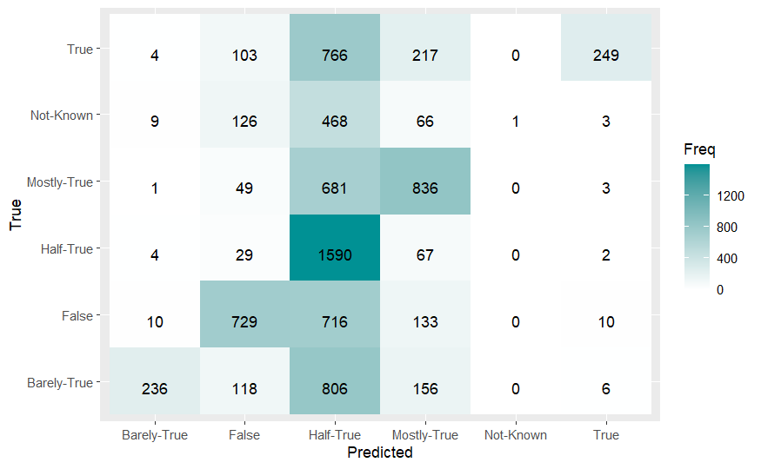
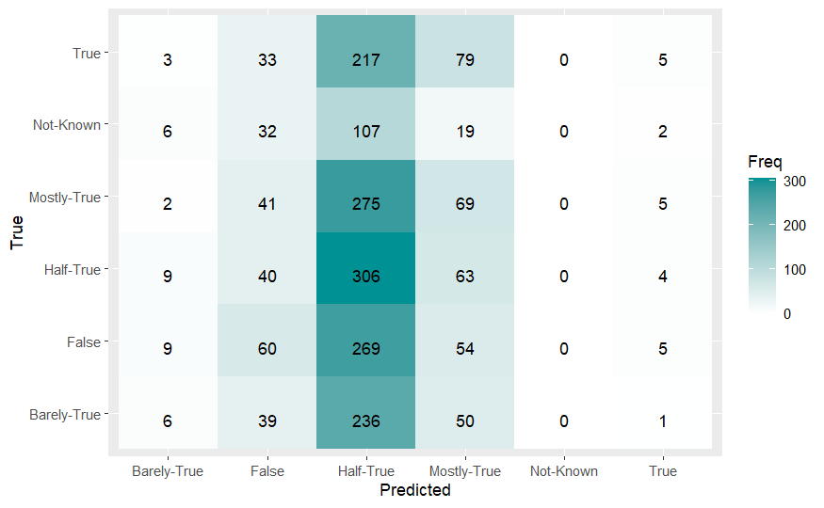
Possible cause analysis
Train
Validation
A large number of errors occur in predicted 'Half True' label.
The farther away the predicted labels are (with the greatest difference), predictions are more difficult, leading to mistakes. This can explain why precision performs much better than sensitivity.
For all labels, they are more likely to be predicted as middle labels, and the distribution of intermediate labels is not significantly higher than others. This is the reason for the low sensitivity and precision.

Slide 51
Possible cause analysis
Train
Validation
The reason for the poor performance of the test set is that it is too small
In fact, with fewer Half-True labels, their predictions may all be worse.
For the labels with the largest distribution, even small changes can have a huge impact, which may be due to the influence of prior.

Slide 52
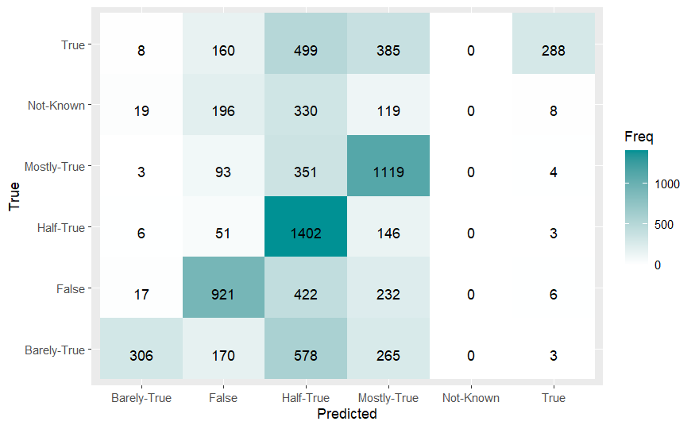
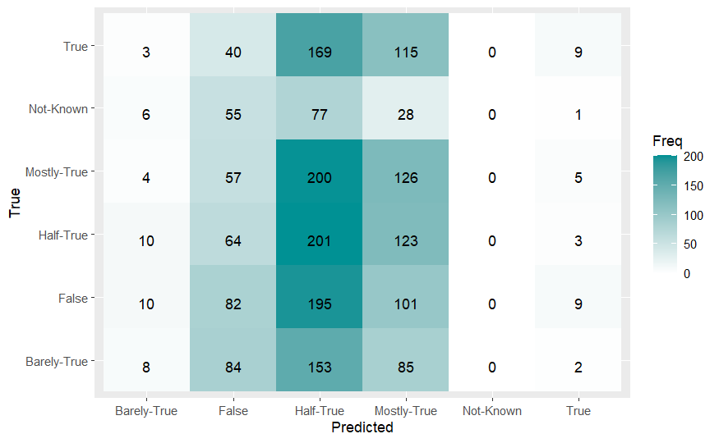
Possible cause analysis
In this section, we deleted 5% of the samples with label 2 (half-true).
Train
Validation
When the sample distribution is more uniform, the prediction performance is better.

Slide 53
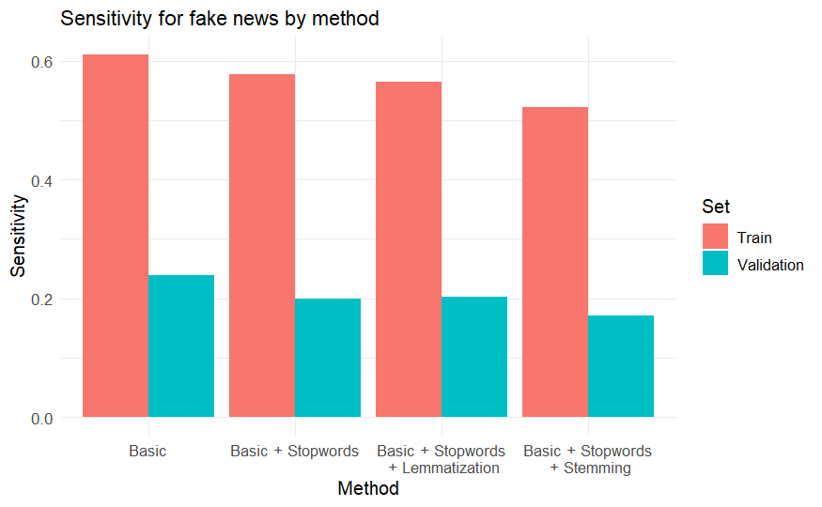
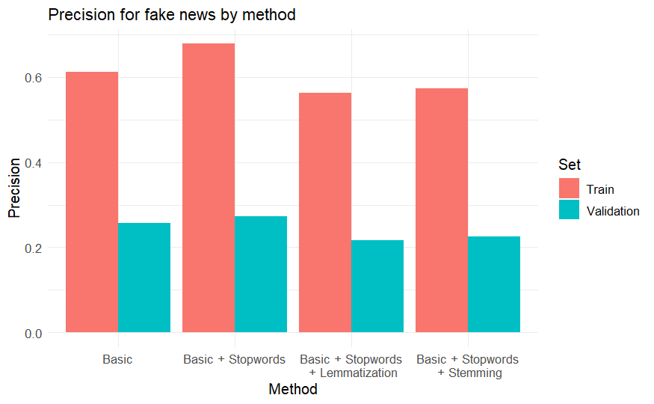
Possible cause analysis
In this section, we deleted 5% of the samples with label 2 (half-true).
When the sample distribution is more uniform, the prediction performance is better.

Slide 54
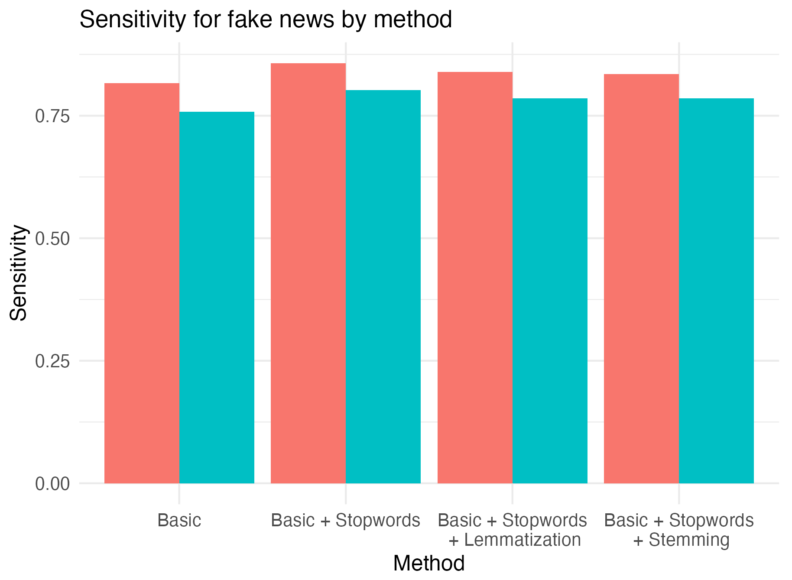
Results: binary classification
Sensitivity:
In binary classification, sensitivity performs well.
The role of preprocessing is still limited

Slide 55
Results: binary classification
Sensitivity:
We can detect more than 75% of the fake news!

Slide 56
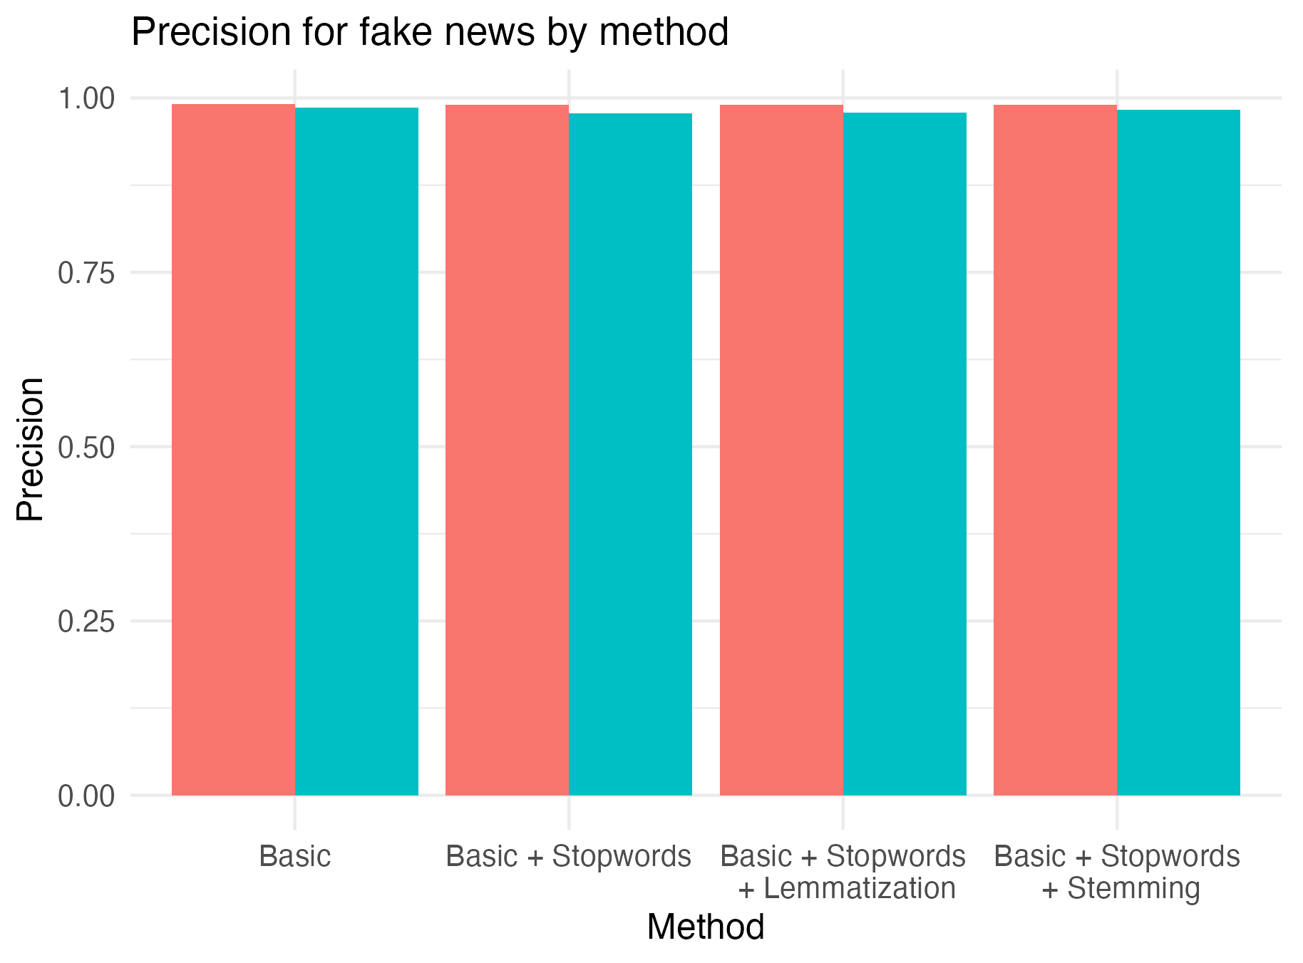
Results: binary classification
Precision:
In binary classification, the precision is almost 1.
The model almost never makes incorrect predictions

Slide 57
Results: binary classification
Precision:
When we classify news as fake, we are almost always right!

Slide 58
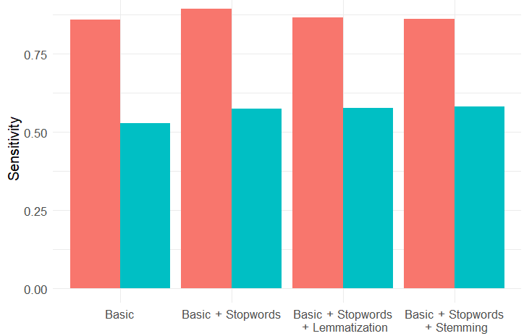
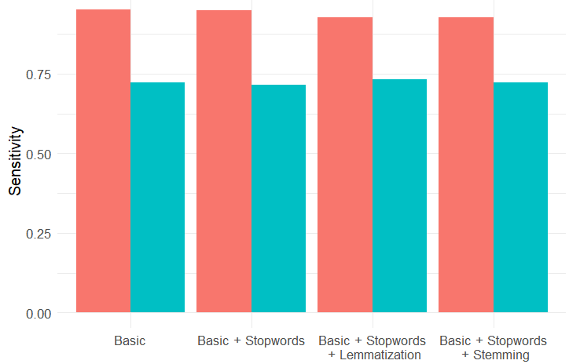
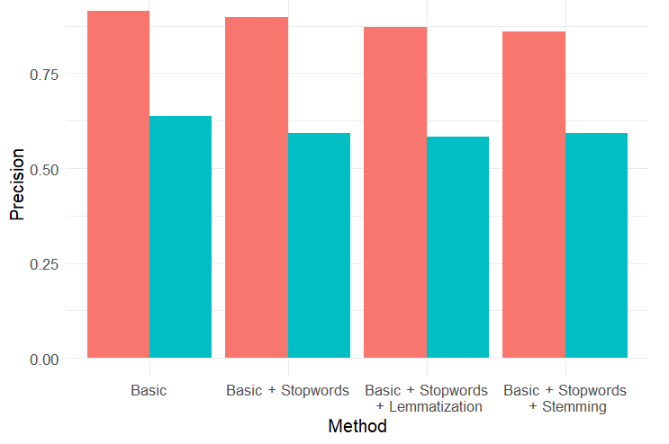
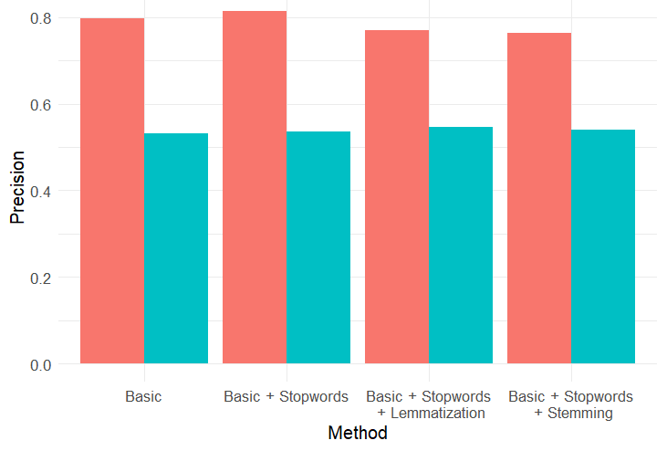
Results: reducing multi-class to binary classification
The two images on the left show binary classification using labels 0 (barely-true) and 5 (true)
The two images on the right show binary classification using labels 2 (half-true) and 3 (mostly-true)

Slide 59
Results: reducing multi-class to binary classification
Due to significant prior knowledge, it performs well. The performance of training sets with more samples is similar to that in binary classification sets

Slide 60
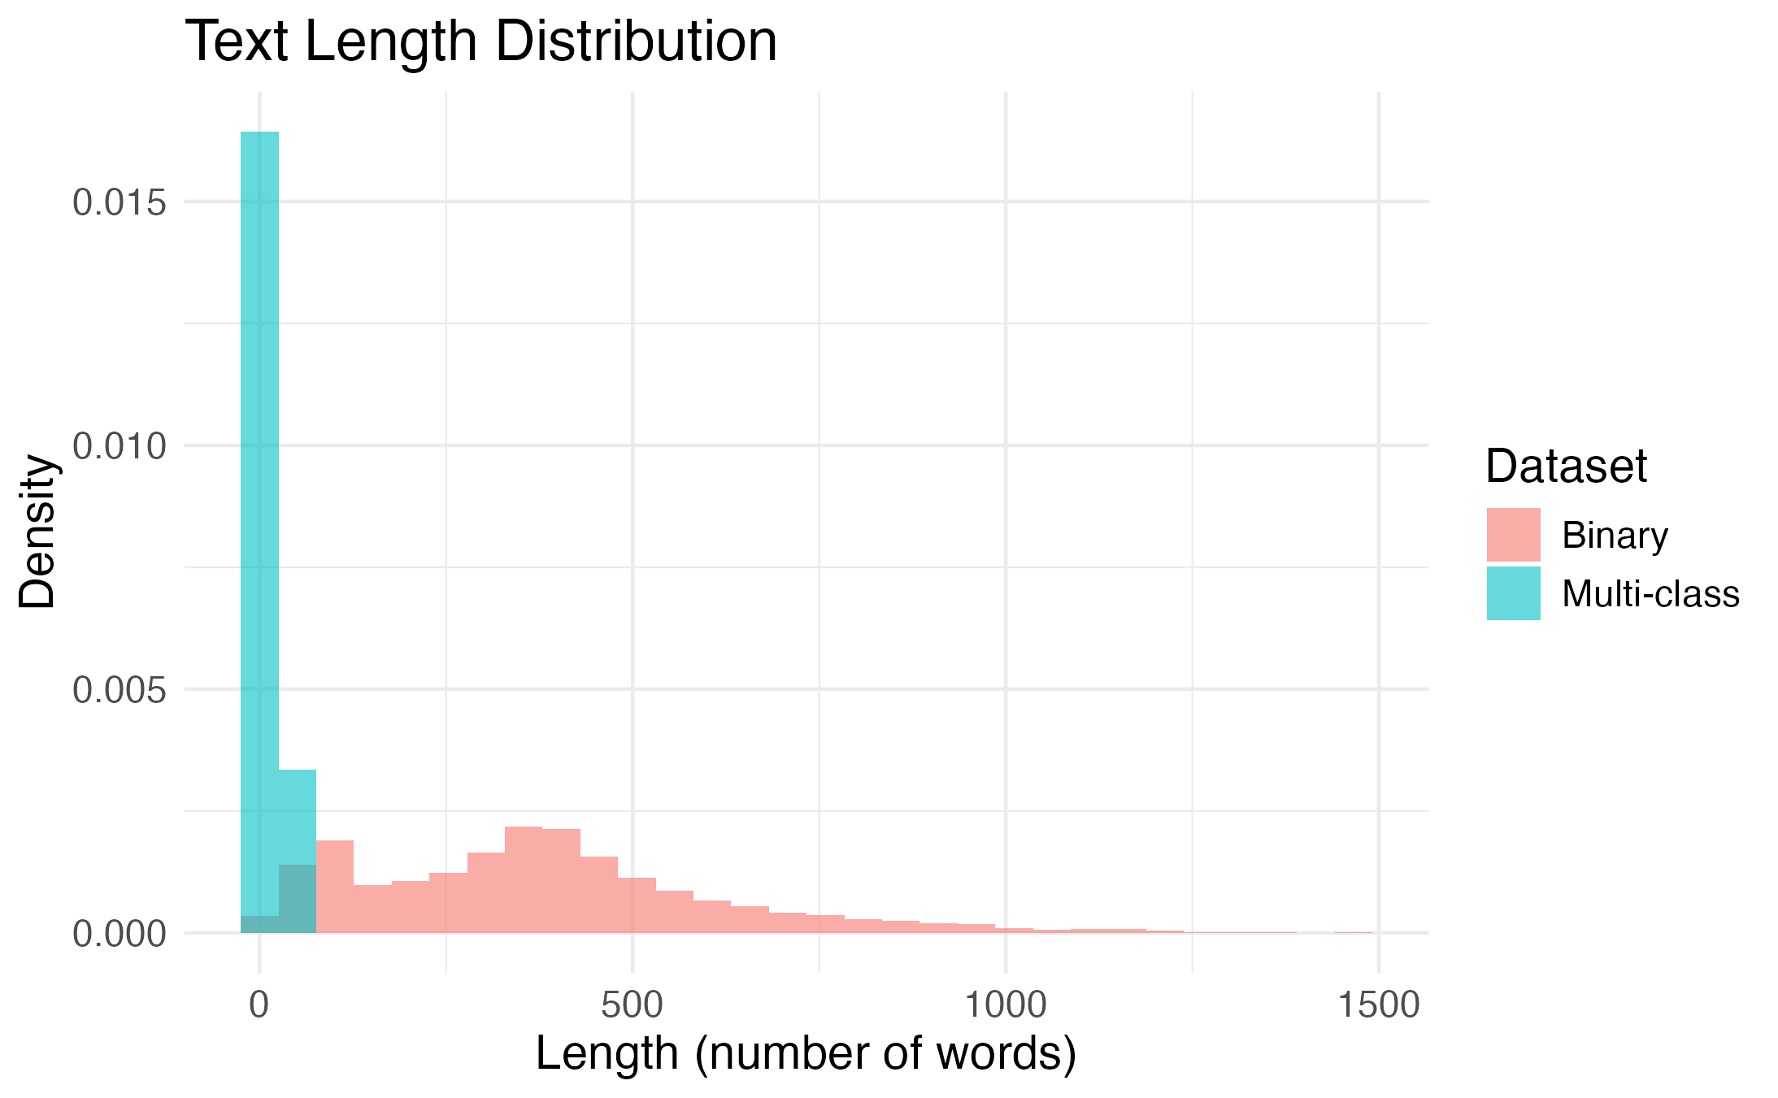
Discussion: text length distribution
The length of the inputs is significantly lower for the multi-class dataset, compared to the binary case.
This may cause the predictions to rely more heavily on the prior for the multi-class data.

Slide 61
Concluding remarks
Tackled the problem of fake news classification using the Naive Bayes method.
Applied the method to two different datasets:
Fake News Content Detection (multi-class data)
Fake News Classification (binary data)
Tested several text processing techniques in order to improve the performance of the model:
Stopword removal
Stemming
Lemmatization
The method displayed significant limitations in the multi-class scenario, but performed very well on binary data.

Slide 62
Thank you
for your attention!
Any Questions?
Group members:
Franco Aquistapace, Daize Li, Hooman Sabzi

